Slide 1
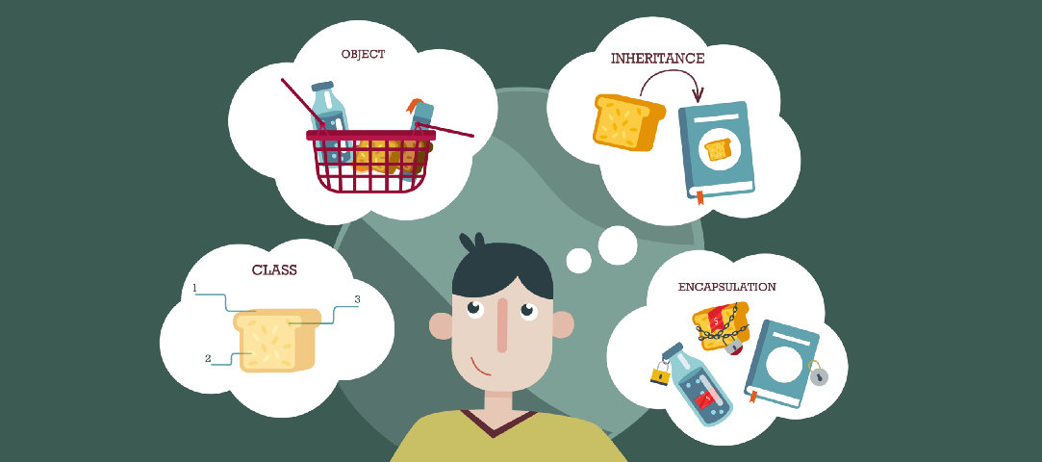
Introduction: Object Oriented Programming
Afsara Tasneem Misha
Lecturer
Department of CSE
Daffodil International University

Slide 2
Today’s Contents
Structured Language and Object-oriented Language
Why OOP?
Basic concepts of OOP

Slide 3
Structured Language and Object-oriented Language

Slide 4
Structured / Procedure Programming Methodology (SPM)

Slide 5
Basic features of SPM
Emphasis on doing algorithms.
Large Programs are divided into smaller programs known as Functions
Most of the function shares global data.
Data move around the system globally from function to function.
Function transfers the data from one form to another.
Employs top-down approach of Programming.
Example: C, Pascal, FORTRAN

Slide 6
Problems with Structured Programming Methodology (SPM)
Reach their limit when project becomes too large.
Large program became more complex.
Functions have unrestricted access to global data.

Slide 7
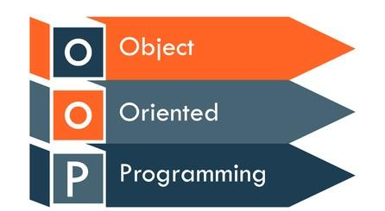
OOP - Breaking the Barriers of SPM

Slide 8
Key Points
Took the best ideas of SPM and combine with several new concepts.
Combine into a single unit both data and the functions that operate on that data.
You can’t access the data directly.
The data is hidden, so it is safe from accidental alteration.
Data encapsulation and data hiding are key terms in the description of object-oriented languages.

Slide 9
The striking features of OOP
Emphasis on data rather than the procedure.
Programs are divided into objects.
Data are hidden and can’t be accessed by external functions
Object may communicate with each other through methods (functions).
New data & functions can be easily added whenever necessary.

Slide 10
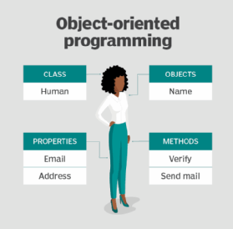
Concepts of OOP
Object
Class
Methods
Instance Variables (Properties)

Slide 11
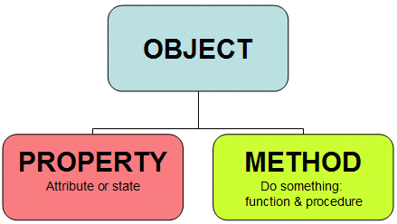
1. Object
Real world entity.
Bundle of related variables and functions (also known methods).
Objects share two characteristics:
1. Properties / State
2. Method / Behavior (Functionalities)

Slide 12
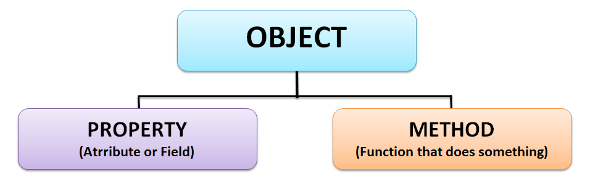
Two characteristics of Object
Objects share two characteristics:
1. Properties / State
State is a well-defined condition of an item.
A state captures the relevant aspects of an object
2. Method / Behavior (Functionalities)
Behavior is the observable effects of an operation or event

Slide 13
Example
Object: House
States: Color
Location
Behaviors: Close/open doors

Slide 14
Try?
Object: Car
States(Properties): ?
Behaviors(Functions): ?

Slide 15
Try?
Object: Car
States(Properties): Color, Model#, Wheel
Behaviors(Functions): Move, Break

Slide 16
Try?
Object: ?
States(Properties): ?
Behaviors(Functions): ?

Slide 17
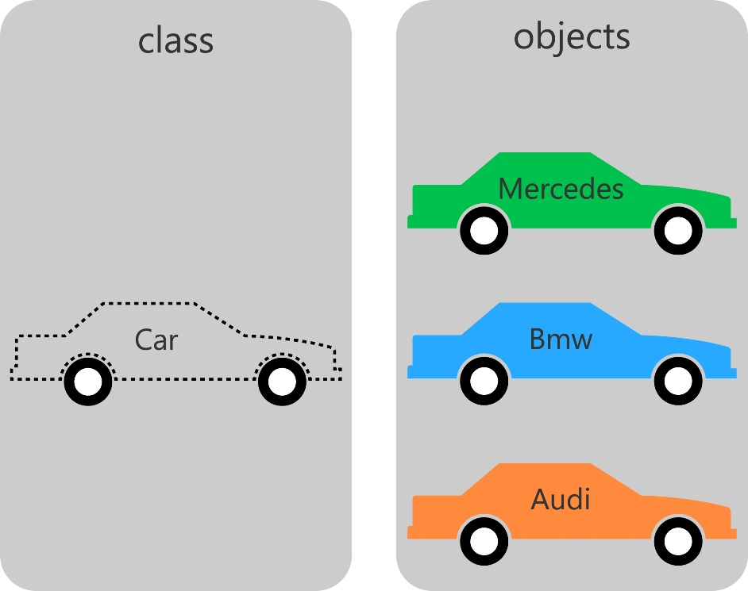
2. Class
A class can be defined as a template/blueprint of an object that describes the behaviors/states that object.

Slide 18
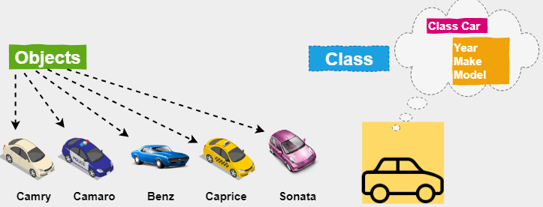
Class: A template/blueprint of an objects

Slide 19
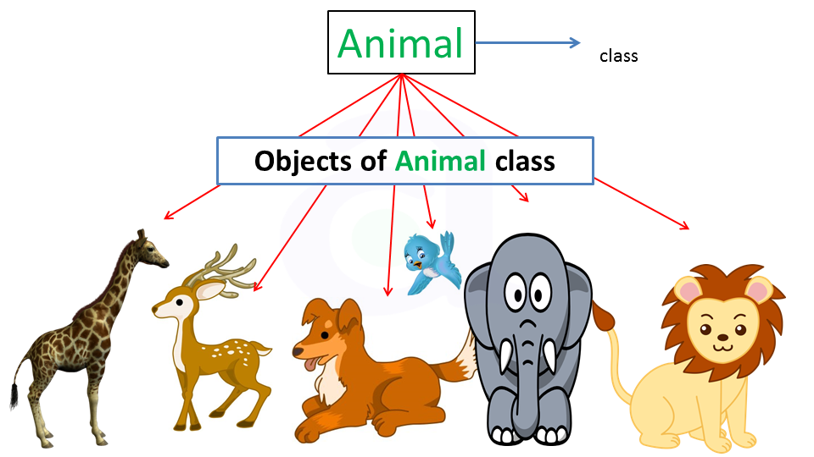
Class: A template/blueprint of an objects

Slide 20
Object Oriented Analysis

Slide 21

What is Object Oriented Analysis?
Account
Account Holder
Monthly
Transaction
Banking Software
Branch
Employee
Problem Domain
Objects
Noun Phrase

Slide 22
Have a try
?
?
?
?
University
?
Problem Domain
Objects

Slide 23
SelfWork
?
?
?
?
?
?
Problem Domain
Objects

Slide 24
Detailing Objects
Account Holder
Bank
Account Holder
Has: name, contact no, accounts
Account
Branch
Account
Has : A/C Number, Balance, Opening Date, Account Holder details
Does:
Deposit money,
Withdraw money
Branch
Has: Name, Location,
No of accounts
Does: Create new accounts, make transaction
Employee
Employee
Has: name, id, email,
salary
Does: Handle banking transactions

Slide 25
Detailing Objects
Bank
Account Holder
Attributes : name, contact no, accounts
Account
Attributes : Number, Balance, Opening Date. Account Holder
Function :
Deposit given amount
Withdraw given amount
Branch
Attributes: Name, Location,
No of accounts
Function: Create new accounts
Employee
Attributes : name, id, email,
salary
Functions: Handle banking transactions

Slide 26
Objects are inter-connected
Account Holder
Has: name, contact no, accounts
Account
Has : Number, Balance, Opening Date. Account Holder
Does:
Deposit given amount
Withdraw given amount
Branch
Has: Name, Location,
No of accounts
Does: Create new accounts
Employee
Has: name, id, email,
salary
Does: Handle banking transactions

Slide 27
Detail objects of University and Find their inter-connection
?
?
?
?
University
?
Problem Domain
Objects

Slide 28

Thank you!

